Slide 1
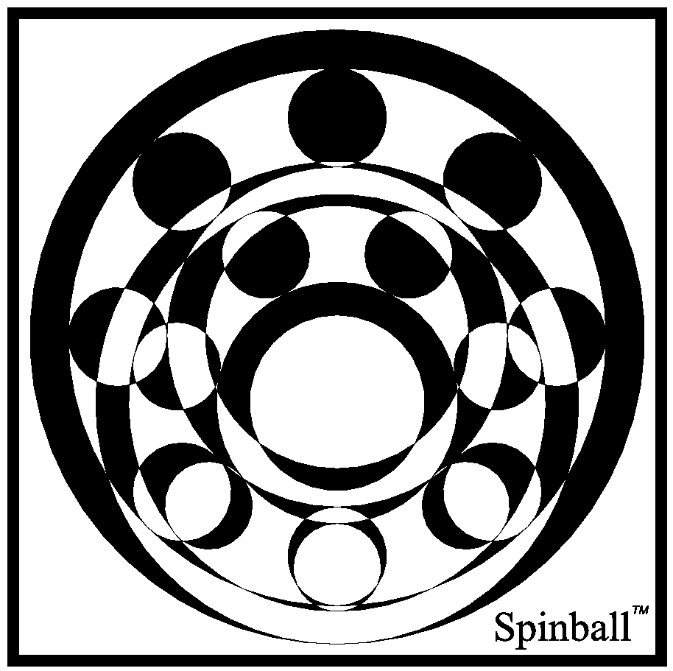

Slide 2
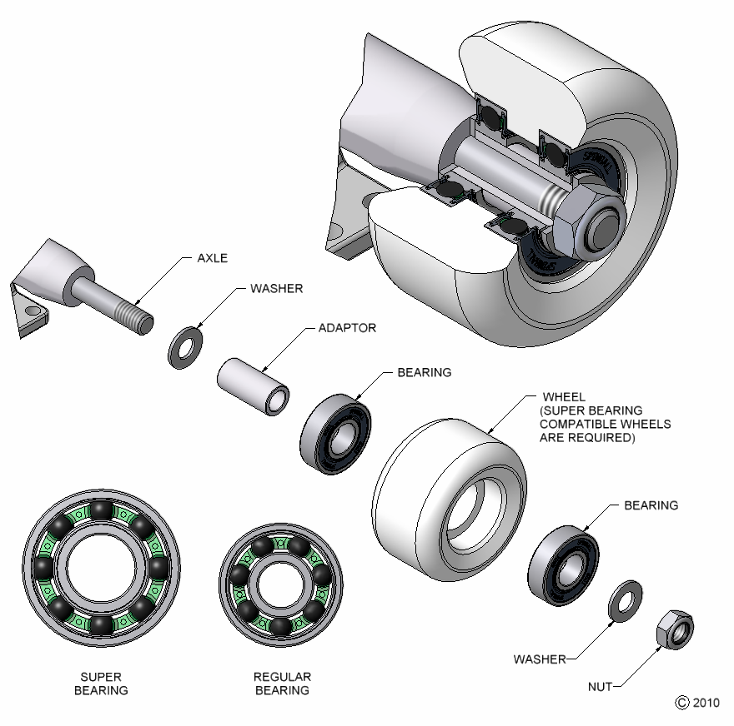
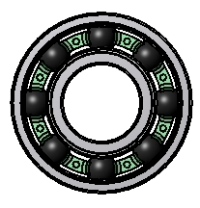
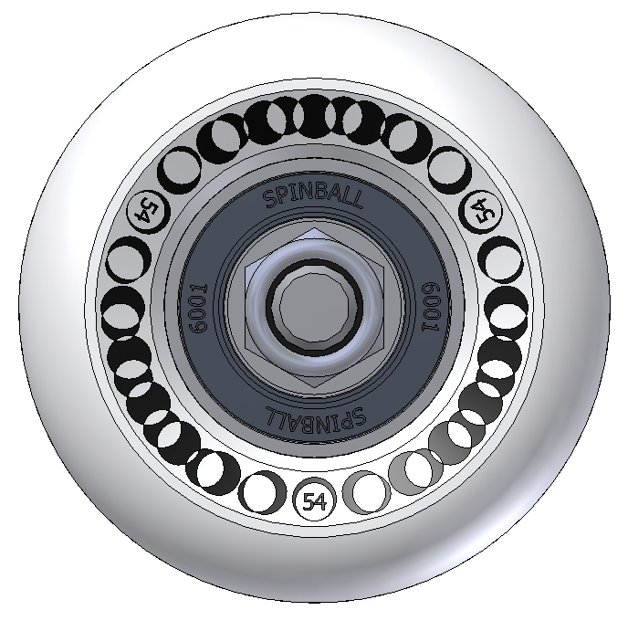
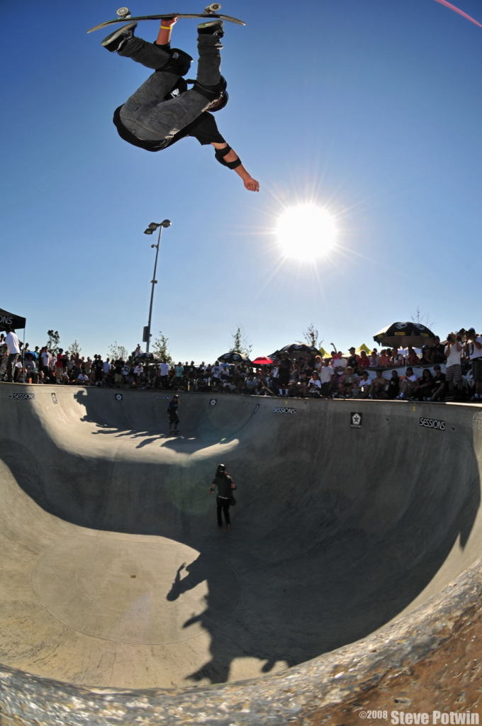
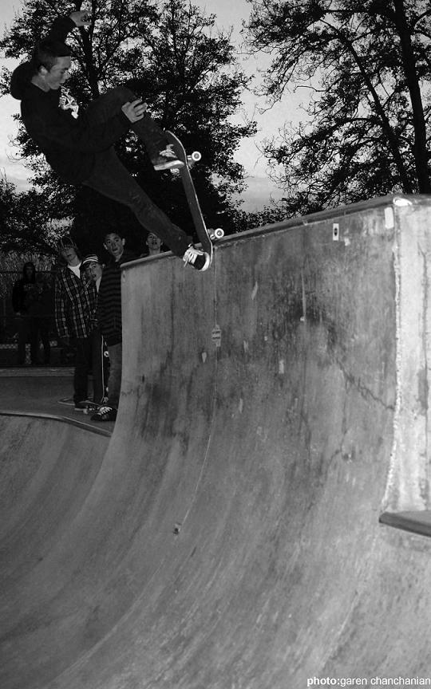
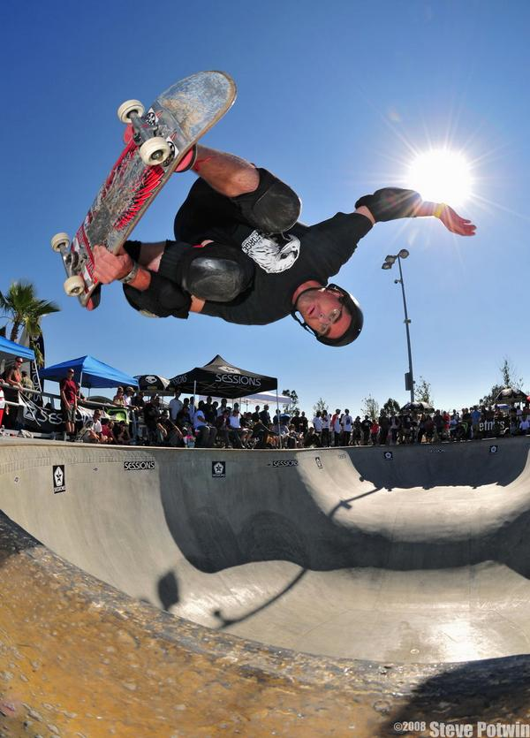
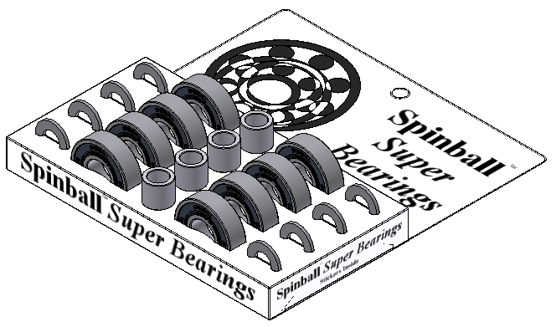
Spinball Super Bearings
TM
Bearings
Wheels
Photo 1
Photo 2
Photo 3
Shop

Slide 3
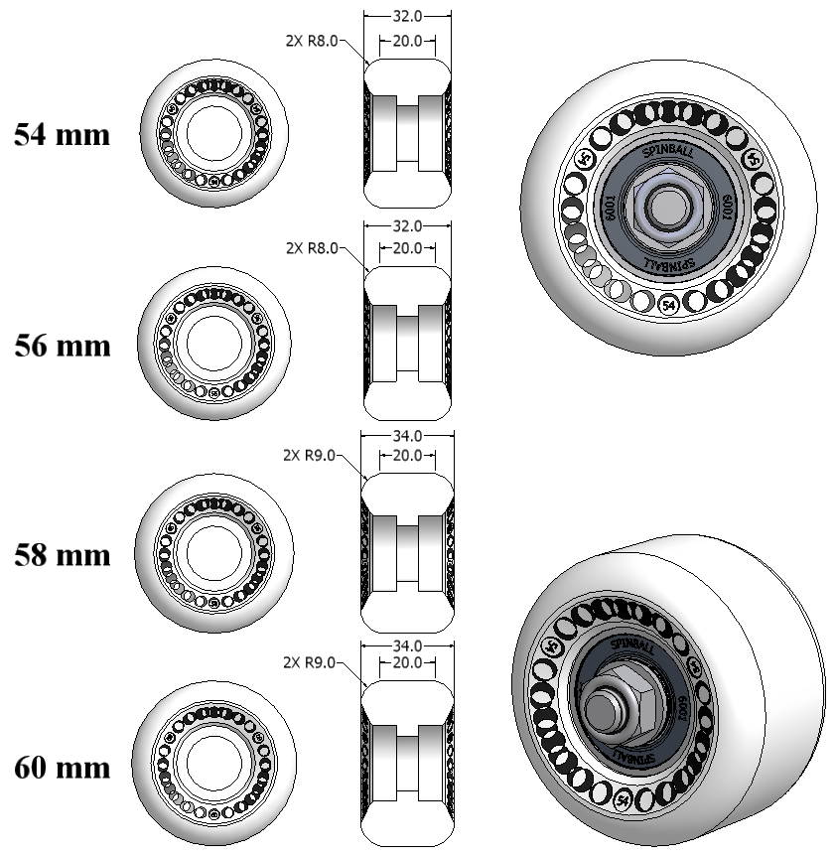
Spinball Super Bearing Wheels
TM
Bearings
Highest Grade Urethane - Superthane
99A Durometer
White
Wheels
Photo 1
Photo 2
Photo 3
Shop

Slide 4
Bearings
Wheels
Photo 1
Photo 2
Photo 3
Shop
Nate Linford, SJ Lake Cunningham Regional Skate Park

Slide 5
Bearings
Wheels
Photo 1
Photo 2
Photo 3
Shop
Chris Henderson, Sunnyvale Skate Park

Slide 6
Bearings
Wheels
Photo 1
Photo 2
Photo 3
Shop
Tony Loverde, SJ Lake Cunningham Regional Skate Park

Slide 7
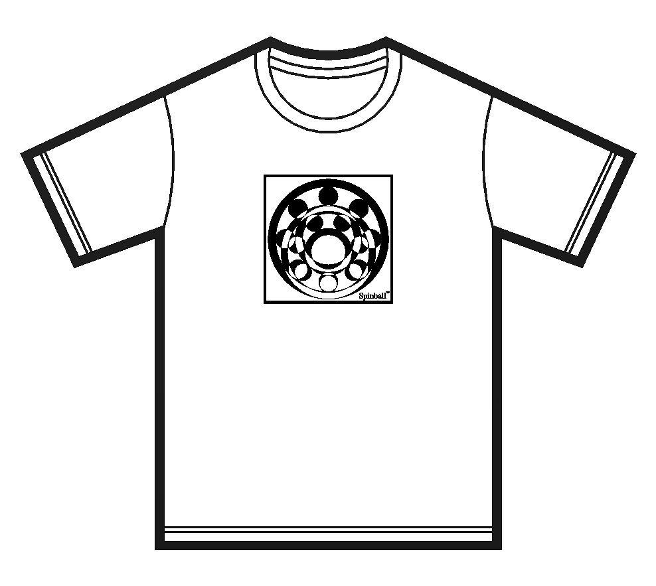
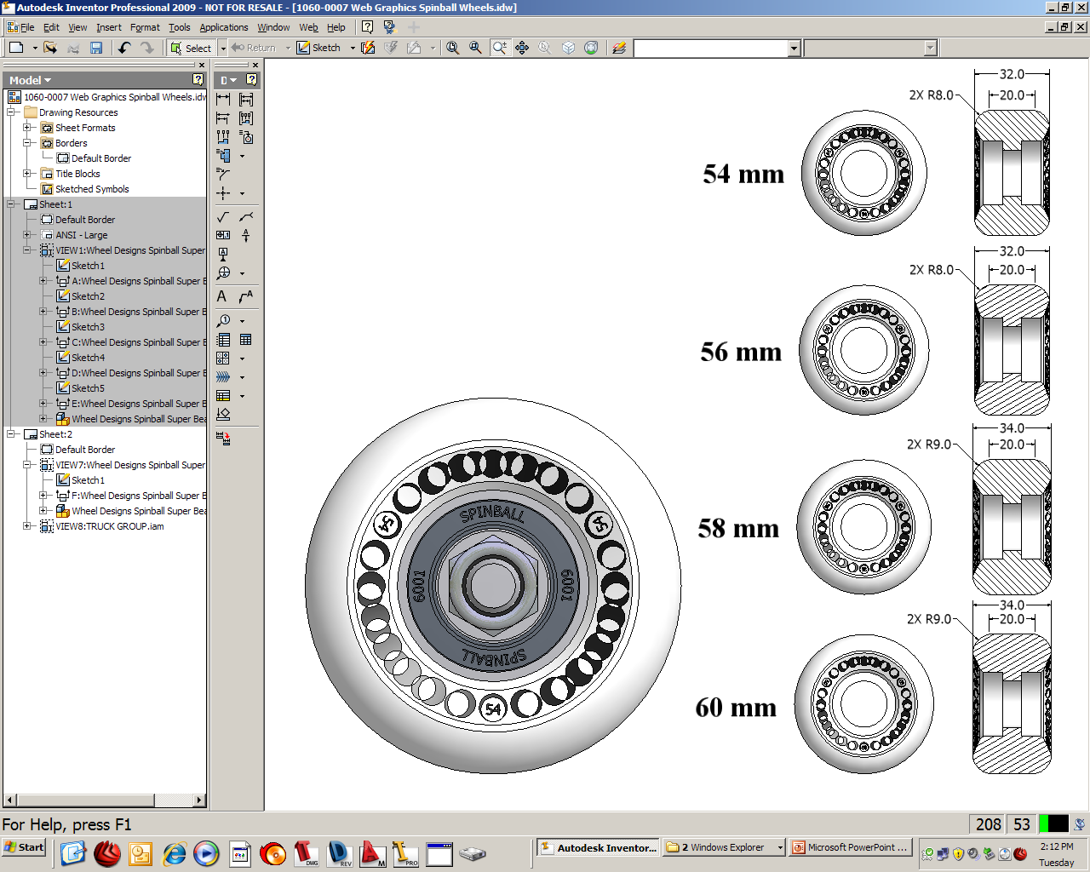
Spinball Shop
TM
Red
Green
Blue
Black
White
Gray
Bearings
Medium – Large - Extra-Large
Wheels
Super Bearings
$60 per set
T-Shirts
$15 each
Photo 1
Photo 2
Photo 3
Super Bearing Wheels
$32 per set
Shop

